Slide 1
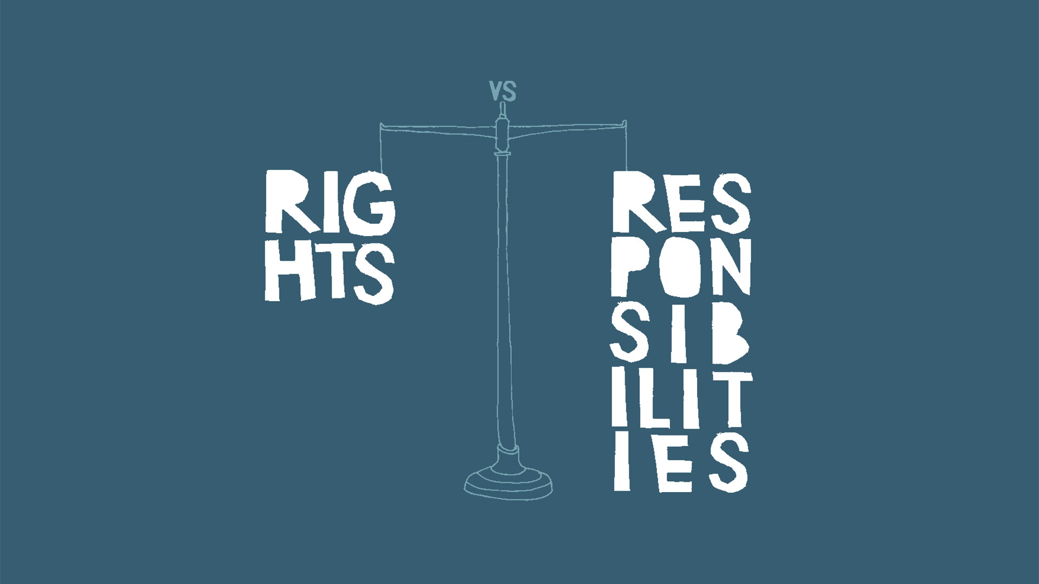
Klaus Stoll
CEO IITF
Digital Rights as the foundation of a new digital economy.

Slide 2

The Goal of this presentation is
to show that digital human rights
and responsibilities are the
foundation of a new
sustainable digital
economy.

Slide 3

Digital ecosystem/economy
Historical Touchpoints
1989 Tim Berners-Lee WWW @ HTTP
1993 Graphic Browser, (Mosaic)
1997 US Taxpayer Relief Act lowering Capital Gains Tax, resulting in huge venture capital investments into digital technologies ventures.

Slide 4

Early2000:
Dot com bubble crash

Slide 5


Digital economy in search of a business model:
How to get customers
to pay for something
they expect to be free?

Slide 6

The answer:
2001 Google systematically developed its capacity to make predictions about its users and started selling the ability to manipulate.
Many companies followed Google and offered their digital gadgets free of charge in exchange for personal data that could be monetized:
Surveillance capitalism was born.

Slide 7

Surveillance Capitalism separates what belongs together!
Price / Product
Product / Responsibility
Internet / Governance
& Law
What you say / What you do
Society / Knowledge
Rights / Responsibility
Humanity reduced to a data source

Slide 8

The digital ecosystem and economy under stress: Civil Society
Unable to participate in digital policy making processes
Fundamental human rights are not valid and implemented in cyberspace
Privacy and security concerns

Slide 9

The digital ecosystem and economy under stress: Governmental Sector
Sovereignty stops at the border.
Private sector entities assume the function and role of governments
Temptation to use digital technologies to “protect“, (control) citizenship

Slide 10

The digital ecosystem and economy under stress: Private Sector
Governmental regulations
Lack of consumer trust
Inability to retain staff
Pariah Status
Fighting off “Unicorns” - high yield monopolistic startups.

Slide 11
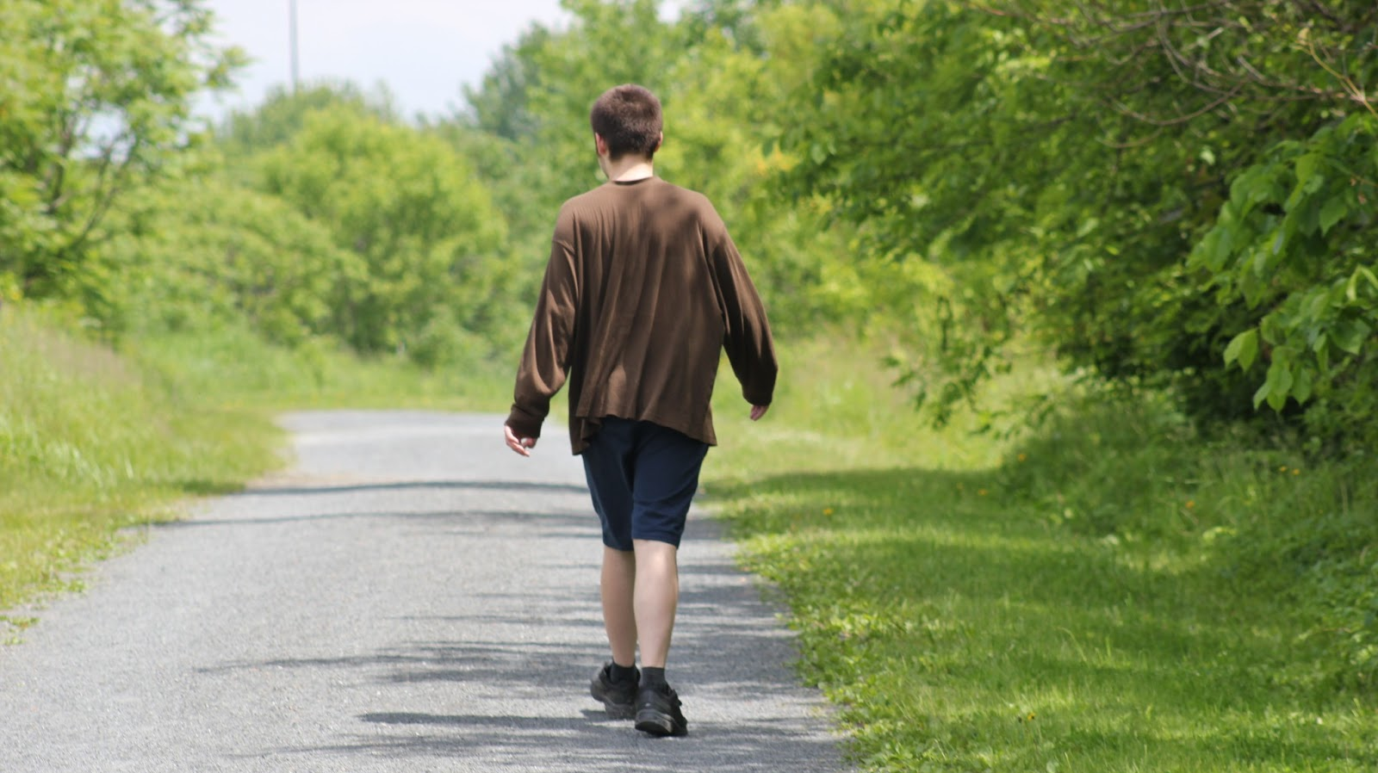
Choices:
When the lack of Trust causes too much hurt,
digital users will make a value judgement and walk away from harmful digital practices

Slide 12

Lack of trust causing the current digital economy bubble to burst!
Current disrespect for fundamental digital rights results in a lack of trust.
“As digital technology becomes an ever more central part of every aspect of people’s lives, people should be able to trust it. Trustworthiness is also a prerequisite for its uptake.”(European Commission White Paper on Artificial Intelligence)

Slide 13

A Lack of Trust causing the current digital economy bubble to burst!
We can already clearly see the evidence of the surveillance capitalism bubble bursting.
Studies confirm that a lack of trust has become a real factor that limits, even endangers, the digital economy.
The “Brands in Motion 2018“ study questioned 25.000 consumers world-wide and 93 Percent of the consumers in Germany demanded the ethical use of digital technologies.
A PEW Trust Study from 2019 showed that in 2015, ca 70% of consumers trusted the digital companies. This trust declined to 50% in 2019.

Slide 14

Choices: “Meta” your way out
Digital companies can react in two ways:
1. Go FaceBook and adopt a new business model that is even more intrusive and harmful.

Slide 15

Choices: Restore Trust
To restore trust we need to identify the needs and interests, expressed as values, that are common to all concerned.

Slide 16

The UDHR represents the fundamental human values that are common to us all.
Trust exists where the fundamental human rights are respected.
The UDHR represents the Constitution of our living together.
Without respect for the fundamental human rights there is no true economic development and sustainability.

Slide 17
Applied digital human Rights and Responsibilities: Civil Society
Extending civil rights into cyberspace
Ensuring participation through digital citizenship
Addresses privacy and security concerns, prevents servitude

Slide 18

Applied digital human Rights and Responsibilities: Governments
Governments will be able to share sovereignty in cyberspace
Provide sound basis for dialogue and treaties with other governments.
Reduce need for punitive regulation and legislation.

Slide 19
Applied digital human Rights and Responsibilities:
Private Sector
Reducing the need for restrictive regulation
Gain acceptance and trust
Attract and retain staff
Access to investment and support
Level playing field.
- Real innovation

Slide 20
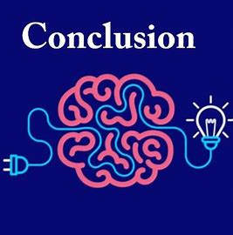
Digital rights and responsibilities are the foundation of a new sustainable digital economy.
The goal is to extent out fundamental human rights into cyberspace with its cyber economy.
We next need to express and embody our digital human rights in a Digital Bill of Rights and Responsibilities.

Slide 21


For further information visit:
iitf.online
Contact:
info@iitf.online

