Slide 1

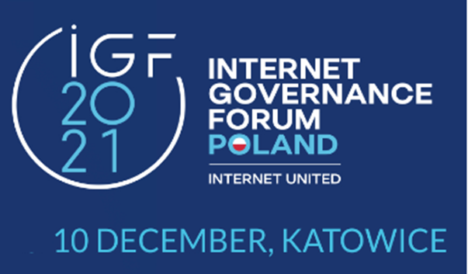
Digital Rights Today and in the Future
Ours to Build
Sam Lanfranco
Prof. Emeritus & Senior Scholar, York University
President, Internet Integrity Task Force (IITF)
Email: Lanfran@yorku.ca

Slide 2
What are Today’s Challenges?
Weak Protection for Digital Rights (& Responsibilities?)
Low Integrity in digital governance, business, & societal entities
Low Trust in digital policies, processes & practices
Goal: Wellbeing & dignity for all in a free & open society
  As Harari reminds us in Sapiens:
  We are what we build, and we can improve.

Slide 3
What Do We Need to Understand?
We are Digital Residents of the Internet ecosystem
Our Virtual & Literal combine to Construct our Reality
(e.g., Virtual Social, Religious, Psychic & Digital spaces)
Good outcomes require Integrity & Trust
Societal Integrity & Trust require Digital Citizenship
Digital Citizenship involves Rights & Responsibilities
Digital Responsibilities are not subservience to government
Responsibilities are reciprocal & protect Mutual Rights
(e.g., anti-masking confusion around “my rights”)

Slide 4
A History Lesson: Context & Political Will
After World War One (1919-)
    Anti-Multilateral against League of Nations
    Bad economics in the Treaty of Versailles
    French & British competition to shape German reparations
    After World War Two (1945-)
        Multilateral support for United Nations & Sister Orgs
        Better Economics in the IBRD, WB, IMF, etc
        Global rights efforts: UDHR and anti-colonial efforts
  Costs of Poor Understanding & Lack of Will
  The Great Depression, the Holocaust, and World War Two
  Without understanding effort is flawed and will is weak

Slide 5
Today’s Internet Ecosystem
Governments: Defend & Abuse Freedoms
  Mix of data privacy (e.g., EU & GDPR) & digital surveillance
  Suspension of expression & assembly (e.g, India & Uganda)
Business: Digital Colonialism & MANA Stocks
    MANA (Meta, Alphabet, Netflix, Amazon) Mana from the cloud
    Digital Colonialism: Like Belgium Congo or East India Company
    Digital Servitude: MANAs own data & build digital personas/profiles
    Metaverse Avatar Control: Extreme digital servitude
Persons: Digital Servitude & Digital Rights
    Today: Digital Servitude: Data mining and influencing behavior
    The Future: Digital Citizenship, Universal Access, and Democracy
Today: Digital Servitude & Digital Exploitation
Tomorrow: Digital Citizenship & Democracy

Slide 6
Future Digital Rights & Responsibilities
(Principles: Northern Star/Southern Cross Navigation Aids)
      A Global Digital Charter and National Bills
        Principles based Digital Rights and Responsibilities (e.g. UDHR)
          Global Charter as a multilateral/multistakeholder project
          National Bills as national multistakeholder projects
      Goals attached to the path going forward
        Global & National Digital Citizenship
        Integrity in Digital Policies, Processes, and Practices
        Trust in Government, Business, Societal Entities & Personal Behavior
        Integrity & Trust in society’s Digital Social Fabric & Social Contract
      Address systemic issues not symptomatic problems

Slide 7
The Work to be Done
Strengthen existing good works
  Greater constituency and stakeholder education
  More principles-based stakeholder policy engagement
Address weaknesses
  Understand Digital Citizenship as a right
  Shift from a Symptomatic to a Systemic perspective
Focus on Responsibilities & Governance
    Rebalance focus on Rights versus Responsibilities
    Extend policy focus beyond Government (e.g., to other entities)

Slide 8
To Move Forward: More Cooks in the Kitchen
Global Charter & National Bills
Not like finding a vaccine or baking a cake
Building Education & Consensus
Understanding (Digital) Citizenship
Understanding (multisector) Governance
Understanding Rights (& Responsibilities)
Understanding the Internet (as an ecosystem)
(Broad) Stakeholder Engagement & Dialogue
A Multitude of Campfires
Literal and Virtual Working Groups
Symptomatic Problem Working Groups
Systemic Issue Working Groups
Multistakeholder Working Groups

Slide 9
Digital Rights Today and in the Future
From Digital Servitude to Digital Democracy
Sam Lanfranco
Prof. Emeritus & Senior Scholar, York University
President, Internet Integrity Task Force (IITF)
Email: Lanfran@yorku.ca
http://www.iitf.online

